Slide 1
Bosnia and Herzegovina Parliamentary Assembly of Bosnia and Herzegovina
Emina Jahić
Secretary of the Joint Committee on Human Rights, Children' Rights, Youth, Immigration, Refugees, Asylum and Ethics
Skopje, 8-9 May 2014

Slide 2
CODE OF CONDUCT FOR REPRESENTATIVES AND DELEGATES IN THE PARLIAMENTARY ASSEMBLY OF BOSNIA AND HERZEGOVINA

Slide 3
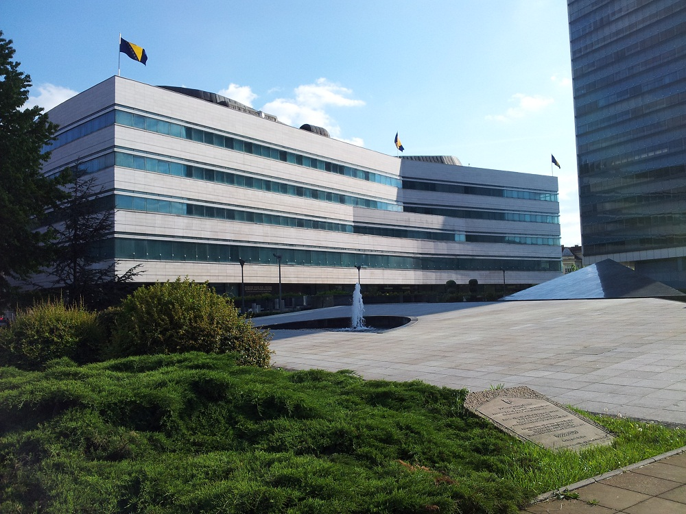

Slide 4
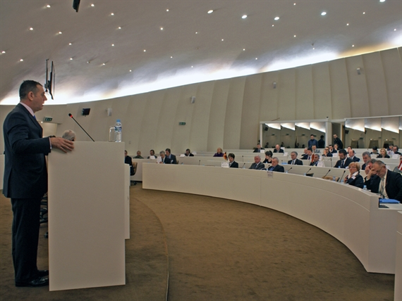
INTRODUCTION
Since the beginning of 1996, the members and officers of the Parliamentary Assembly of Bosnia and Herzegovina, have committed themselves to supporting the ongoing responsibility of the Parliamentary Assembly of the citizens of Bosnia and Herzegovina.

Slide 5
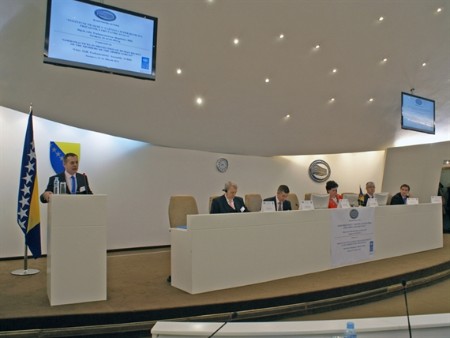
The first step in this direction is the „Code of Conduct for Members of Parliament and a delegate to the Parliamentary Assembly of Bosnia and Herzegovina“, which was adopted in December 2008th.

Slide 6
This Code of Conduct is made respecting the following basic principles:
Officials elected to political office must subordinate their work and actions to the legality and to the general public interest, in accordance with ethical principles defined in this Code;
Non-compliance with these principles undermines the credibility of the Parliamentary Assembly of Bosnia and Herzegovina democracy and the foundations of the rule of Code;
The basic goal of adopting and promoting the Code is strengthening trust between elected officials and citizens;
The whole of civil society must be involved in creating a climate of confidence in the work of the Parliamentary Assembly of Bosnia and Herzegovina.

Slide 7
SUBJECT OF THE CODE OF CONDUCT
The term “elected official” means any representative and delegate holding a mandate in one of the Houses of the Parliamentary Assembly of BiH (hereinafter referred to as Parliament).
The term “function” means any function performed by elected officials under their mandate.
This Code stipulates the standards of behaviour expected of elected officials in performing their duties.
It also informs citizens of the standards of behaviour that they rightfully may expect of their elected officials.

Slide 8
PRINCIPLES
Legality and the public interest
Objectives of fulfilling a mandate
Constraints of fulfilling a mandate

Slide 9
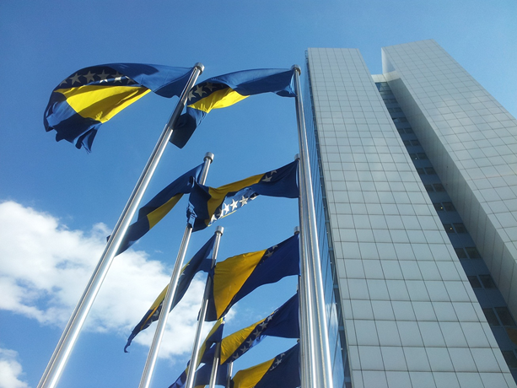
GENERAL ETHICS AND BEHAVIOUR
General ethical principles:
Accountability towards the public;
Honesty;
3) Integrity;
4) Objectivity;
5) Openness.

Slide 10
Behavior of elected representatives
Elected officials shall observe any standards of conduct which the Parliament may prescribe. They shall behave at all times in such a manner that will enhance the dignity and reputation of the House.
In particular :
a) Elected officials are obliged to be regularly present at the Parliament’s, committees’ and working bodies’ sessions. They can be absent only under justified circumstances in accordance with the Rules of Procedure;
(b) Elected officials must not leave a session during the address of Speaker or a guest;
(c) Elected officials should avoid making statements that are not supported by evidence;
(d) Elected officials must not sit or stand with their back turned towards the Speaker;
(e) Elected officials must not consume alcohol or food during session;

Slide 11
(f) Elected officials must not read books, newspapers, or other publications unrelated to their parliamentary duties
during session;
g) Elected officials must not use mobile phones during session nor use portable computers in such a way that
disturbs session;
(h) Elected officials must not display flags and emblems during session;
(i) Elected officials must not conduct conversations during session unless it is necessary to do so, provided they
do not disturb the session;
(j) Elected officials must not speak against another person, interrupt speaker or in any way undermine the session,
order in the halls, offices and hallways;

Slide 12
(k) Elected officials must not use any expressions or words that might insult or belittle others and those who are different, expressions and their synonyms that might insult human dignity and undermine dignity of the Parliament, and encourage hatred and violence. In their work they shall exclude any partiality towards different political ideology, race, religion, nation, gender or any other prejudice;
(l) Conversation between elected officials in the hallway must not be loud in such a way to interrupt session;
(m) When participating in the sessions or any other public places, where they act as representatives of the Parliament, elected officials shall be dressed appropriately.

Slide 13
OBLIGATIONS OF ELECTED OFFICIALS
In performing function:
Ban on exercising authority to one’s own advantage;
Conflict of interests;
Limit on concurrent performing of two or more functions;
Exercise of powers;
Ban on corruption;
Observation of budgetary and financial discipline.
In termination of Duty:
Ban on acting to ensure advantage after termination of the mandate.

Slide 14
MANNER OF SUPERVISION
Declaration of interests
Compliance with internal and external supervisory measures

Slide 15
RELATIONS WITH THE PUBLIC, staff and THE MEDIA
Publishing and giving reasons for decisions
Appointment and promotion of administrative staff
Relations with the media

Slide 16
MEASURES FOR VIOLATION OF THE CODE
TYPES OF :
Warning;
Fine;
c) Public warning with dissemination.
IMPOSING THE MEASURES:
a) A warning shall be given for minor violations;
b) Whereas there will be a fine and public warning for serious violations of the Code.

Slide 17
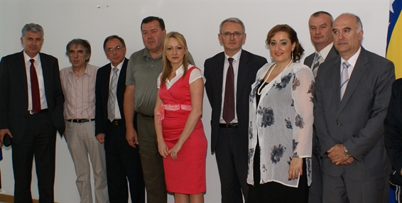
JURISDICTION AND THE RIGHT TO APPEAL
The Joint Committee on Human Rights, Rights of Children, Youth, Immigration, Refugees, Asylum and Ethics (hereinafter referred to as the Joint Committee) shall be competent for the implementation and monitoring of the Code and prescription of measures;

Slide 18
An elected official may appeal a pronounced measure by the Joint Committee to the Joint Committee on Administrative Affairs of the Parliament;
In a separate act, the Joint Committee shall stipulate a procedure for the prescription of the measures, including an appeals procedure;
The Parliament shall at least once a year consider and evaluate the work of the Joint Committee with regards to the implementation of the Code;
Statemant of readiness.
Since the Code of Conduct has been adopted in 2008, there was no case of violent of the Code of Conduct provisions.

Slide 19
THANK YOU FOR YOUR ATTENTION
Emina Jahić
Secretary of the Joint Committee on Human Rights,Children' Rights, Youth, Immigration, Refugees, Asylum and Ethics
Emina.Jahic@parlament.ba
www.parlament.ba

Slide 20
